Slide 1
Cryptography and Network Security Chapter 5
Fifth Edition
by William Stallings
Notes:
‹#›
Lecture slides by Lawrie Brown for “Cryptography and Network Security”, 5/e, by William Stallings, Chapter Chapter 5 –”Advanced Encryption Standard”.

Slide 2
Chapter 5 –Advanced Encryption Standard
"It seems very simple."
"It is very simple. But if you don't know what the key is it's virtually indecipherable."
—Talking to Strange Men, Ruth Rendell
Notes:
‹#›
Intro quote.

Slide 3
AES Origins
clear a replacement for DES was needed
have theoretical attacks that can break it
have demonstrated exhaustive key search attacks
can use Triple-DES – but slow, has small blocks
US NIST issued call for ciphers in 1997
15 candidates accepted in Jun 98
5 were shortlisted in Aug-99
Rijndael was selected as the AES in Oct-2000
issued as FIPS PUB 197 standard in Nov-2001
Notes:
‹#›
The Advanced Encryption Standard (AES) was published by NIST (National Institute of Standards and Technology) in 2001. AES is a symmetric block cipher that is intended to replace DES as the approved standard for a wide range of applications. The AES cipher (& other candidates) form the latest generation of block ciphers, and now we see a significant increase in the block size - from the old standard of 64-bits up to 128-bits; and keys from 128 to 256-bits. In part this has been driven by the public demonstrations of exhaustive key searches of DES. Whilst triple-DES is regarded as secure and well understood, it is slow, especially in s/w. In a first round of evaluation, 15 proposed algorithms were accepted. A second round narrowed the field to 5 algorithms. NIST completed its evaluation process and published a final standard (FIPS PUB 197) in November of 2001. NIST selected Rijndael as the proposed AES algorithm. The two researchers who developed and submitted Rijndael for the AES are both cryptographers from Belgium: Dr. Joan Daemen and Dr.Vincent Rijmen.

Slide 4
The AES Cipher - Rijndael
designed by Rijmen-Daemen in Belgium
has 128/192/256 bit keys, 128 bit data
an iterative rather than Feistel cipher
Advanced Encryption Standard
NIST in 2001
Symmetric Block Cipher
processes data as block of 4 columns of 4 bytes
operates on entire data block in every round
widely used in today’s world
Notes:
‹#›
The Rijndael proposal for AES defined a cipher in which the block length and the key length can be independently specified to be 128,192,or 256 bits. The AES specification uses the same three key size alternatives but limits the block length to 128 bits. Rijndael is an academic submission, based on the earlier Square cipher, from Belgium academics Dr Joan Daemen and Dr Vincent Rijmen. It is an iterative cipher (operates on entire data block in every round) rather than feistel (operate on halves at a time), and was designed to have characteristics of: Resistance against all known attacks, Speed and code compactness on a wide range of platforms, & Design simplicity.

Slide 5
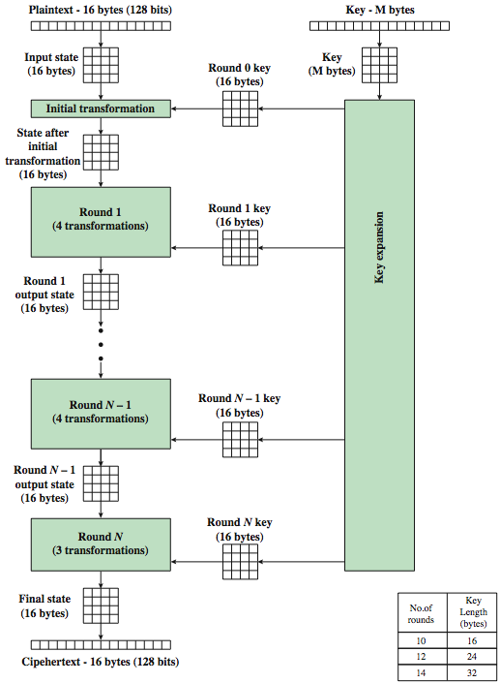
AES Encryption Process
Notes:
‹#›
Stallings Figure 5.1 shows the overall encryption process in AES.

Slide 6
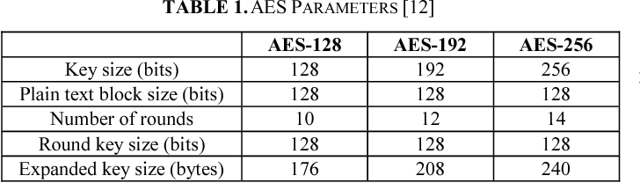
AES Parameters

Slide 7
AES Structure
data block of 4 columns of 4 bytes is state
key is expanded to array of words
has 9/11/13 rounds in which state undergoes:
byte substitution (1 S-box used on every byte)
shift rows (permute bytes between groups/columns)
mix columns (subs using matrix multiply of groups)
add round key (XOR state with key material)
view as alternating XOR key & scramble data bytes
initial XOR key material & incomplete last round
with fast XOR & table lookup implementation
Notes:
‹#›
The input to the AES encryption and decryption algorithms is a single 128-bit block, depicted in FIPS PUB 197, as a square matrix of bytes .This block is copied into the State array, which is modified at each stage of encryption or decryption. After the final stage, State is copied to an output.
The key is expanded into 44/52/60 lots of 32-bit words (see later), with 4 used in each round. Note that the ordering of bytes within a matrix is by column. So, for example, the first four bytes of a 128-bit plaintext input to the encryption cipher occupy the first column of the in matrix, the second four bytes occupy the second column, and so on. Similarly, the first four bytes of the expanded key, which form a word, occupy the first column of the w matrix.
The data computation then consists of an “add round key” step, then 9/11/13 rounds with all 4 steps, and a final 10th/12th/14th step of byte subs + mix cols + add round key. This can be viewed as alternating XOR key & scramble data bytes operations. All of the steps are easily reversed, and can be efficiently implemented using XOR’s & table lookups.

Slide 8
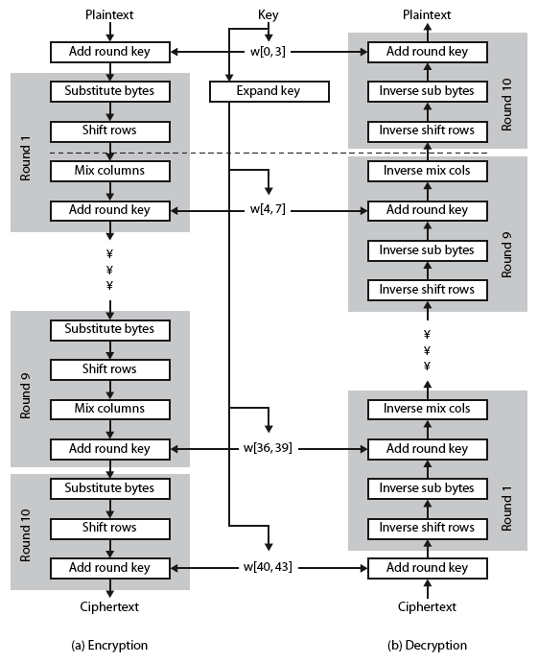
AES
Structure
Notes:
‹#›
Stallings Figure 5.3 shows the structure of AES in more detail. The cipher consists of N rounds, where the number of rounds depends on the key length: 10 rounds for a 16-byte key; 12 rounds for a 24-byte key; and 14 rounds for a 32-byte key. The first N – 1 rounds consist of four distinct transformation functions: SubBytes, ShiftRows, MixColumns, and AddRoundKey, which are described subsequently. The final round contains only 3 transformation, and there is a initial single transformation (AddRoundKey) before the first round, which can be considered Round 0. Each transformation takes one or more 4 x 4 matrices as input and produces a 4 x 4 matrix as output. Figure 5.1 shows that the output of each round is a 4 x 4 matrix, with the output of the final round being the ciphertext. Also, the key expansion function generates N + 1 round keys, each of which is a distinct 4 x 4 matrix. Each round key serve as one of the inputs to the AddRoundKey transformation in each round.

Slide 9
Some Comments on AES
an iterative rather than Feistel cipher
key expanded into array of 32-bit words
four words form round key in each round
4 different stages are used as shown
has a simple structure
only AddRoundKey uses key
AddRoundKey a form of Vernam cipher
each stage is easily reversible
decryption uses keys in reverse order
decryption does recover plaintext
final round has only 3 stages
Notes:
Before delving into details, can make several comments about the overall AES structure. See text for details.
‹#›

Slide 10
AES Transformation Functions
Substitute Bytes
Shift Rows
Mix columns
Add Round Key

Slide 11
Substitute Bytes
a simple substitution of each byte
uses one table of 16x16 bytes containing a permutation of all 256 8-bit values
each byte of state is replaced by byte indexed by row (left 4-bits) & column (right 4-bits)
eg. byte {95} is replaced by byte in row 9 column 5
which has value {2A}
S-box constructed using defined transformation of values in GF(2⁸)
designed to be resistant to all known attacks
Notes:
‹#›
We now turn to a discussion of each of the four transformations used in AES. For each stage, we mention the forward (encryption) algorithm, the inverse (decryption) algorithm, and the rationale for the design of that stage.
The Substitute bytes stage uses an S-box to perform a byte-by-byte substitution of the block. There is a single 8-bit wide S-box used on every byte. This S-box is a permutation of all 256 8-bit values, constructed using a transformation which treats the values as polynomials in GF(2⁸) – however it is fixed, so really only need to know the table when implementing. Decryption requires the inverse of the table. These tables are given in Stallings Table 5.2.
The table was designed to be resistant to known cryptanalytic attacks. Specifically, the Rijndael developers sought a design that has a low correlation between input bits and output bits, with the property that the output cannot be described as a simple mathematical function of the input, with no fixed points and no “opposite fixed points”.

Slide 12
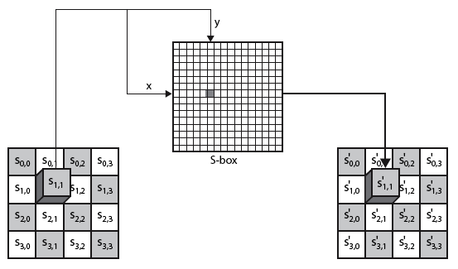
Substitute Bytes
Notes:
‹#›
As this diagram from Stallings Fig 5.5a shows, the Byte Substitution operates on each byte of state independently, with the input byte used to index a row/col in the table to retrieve the substituted value.

Slide 13
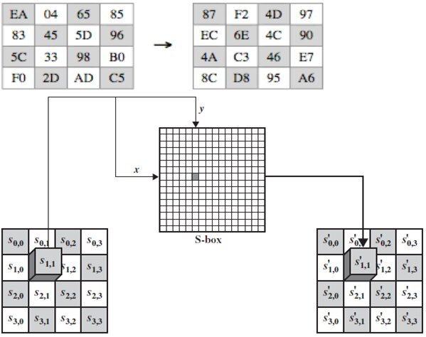
Substitute Bytes Example
Notes:
Show an example of the SubBytes transformation from the text.
‹#›

Slide 14
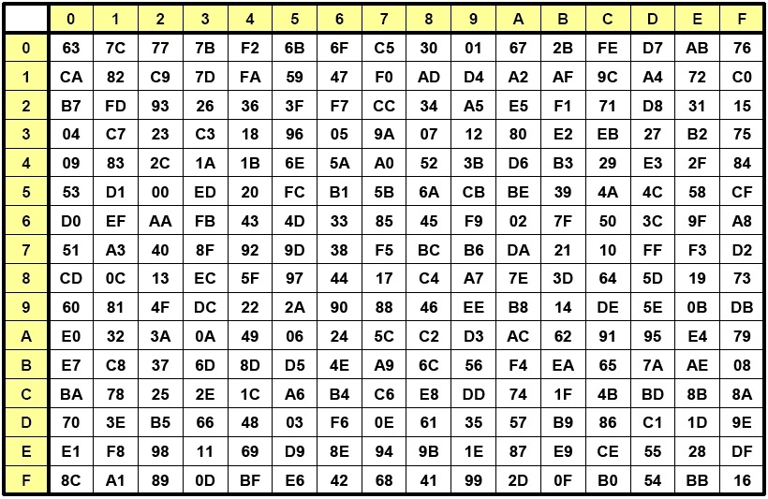
Substitute Bytes

Slide 15
Shift Rows
a circular byte shift in each each
1st row is unchanged
2nd row does 1 byte circular shift to left
3rd row does 2 byte circular shift to left
4th row does 3 byte circular shift to left
decrypt inverts using shifts to right
since state is processed by columns, this step permutes bytes between the columns
Notes:
‹#›
The ShiftRows stage provides a simple “permutation” of the data, whereas the other steps involve substitutions. Further, since the state is treated as a block of columns, it is this step which provides for diffusion of values between columns. It performs a circular rotate on each row of 0, 1, 2 & 3 places for respective rows. When decrypting it performs the circular shifts in the opposite direction for each row. This row shift moves an individual byte from one column to another, which is a linear distance of a multiple of 4 bytes, and ensures that the 4 bytes of one column are spread out to four different columns.

Slide 16
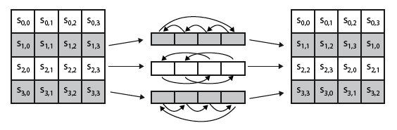

Shift Rows
Notes:
‹#›
Stalling Figure 5.7a illustrates the Shift Rows permutation. Then show an example of ShiftRows from the text.

Slide 17

Mix Columns
each column is processed separately
each byte is replaced by a value dependent on all 4 bytes in the column
effectively a matrix multiplication in GF(2⁸) using prime poly m(x) =x⁸+x⁴+x³+x+1
Notes:
‹#›
The forward mix column transformation, called MixColumns, operates on each column individually. Each byte of a column is mapped into a new value that is a function of all four bytes in that column. It is a substitution that makes use of arithmetic over GF(2^8). Each byte of a column is mapped into a new value that is a function of all four bytes in that column. It is designed as a matrix multiplication where each byte is treated as a polynomial in GF(2⁸). The inverse used for decryption involves a different set of constants.
The constants used are based on a linear code with maximal distance between code words – this gives good mixing of the bytes within each column. Combined with the “shift rows” step provides good avalanche, so that within a few rounds, all output bits depend on all input bits.

Slide 18
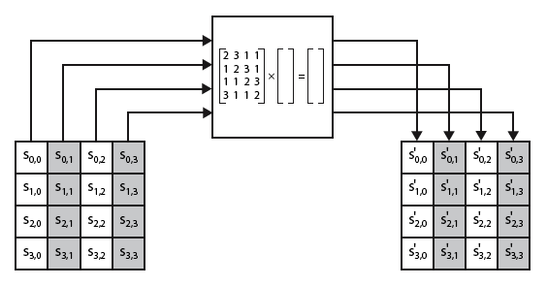
Mix Columns
Notes:
‹#›
Stalling Figure 5.5b illustrates the Mix Columns transformation.

Slide 19

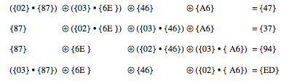
Mix Columns Example
Notes:
Show an example of the MixColumns transformation from the text, along with verification of the first column of this example.
‹#›

Slide 20
AES Arithmetic
uses arithmetic in the finite field GF(2⁸)
with irreducible polynomial
m(x) = x⁸ + x⁴ + x³ + x + 1
which is (100011011) or {11b}
e.g.
{02} • {87} mod {11b} = (1 0000 1110) mod {11b}
= (1 0000 1110) xor (1 0001 1011) = (0001 0101)
Notes:
AES uses arithmetic in the finite field GF(2⁸), with the irreducible polynomial m(x) = x⁸ + x⁴ + x³ + x + 1. AES operates on 8-bit bytes. Addition of two bytes is defined as the bitwise XOR operation. Multiplication of two bytes is defined as multiplication in the finite field GF(2⁸). In particular, multiplication of a value by x (i.e., by {02}) can be implemented as a 1-bit left shift followed by a conditional bitwise XOR with (0001 1011) if the leftmost bit of the original value (prior to the shift) is 1.
‹#›

Slide 21
Mix Columns
can express each col as 4 equations
to derive each new byte in col
decryption requires use of inverse matrix
with larger coefficients, hence a little harder
have an alternate characterisation
each column a 4-term polynomial
with coefficients in GF(2⁸)
and polynomials multiplied modulo (x⁴+1)
coefficients based on linear code with maximal distance between codewords
Notes:
‹#›
In practise, you implement Mix Columns by expressing the transformation on each column as 4 equations (Stallings equation 5.4) to compute the new bytes for that column. This computation only involves shifts, XORs & conditional XORs (for the modulo reduction).
The decryption computation requires the use of the inverse of the matrix, which has larger coefficients, and is thus potentially a little harder & slower to implement.
The designers & the AES standard provide an alternate characterisation of Mix Columns, which treats each column of State to be a four-term polynomial with coefficients in GF(2⁸). Each column is multiplied by a fixed polynomial a(x) given in Stallings eqn 5.7. Whilst this is useful for analysis of the stage, the matrix description is all that’s required for implementation.
The coefficients of the matrix are based on a linear code with maximal distance between code words, which ensures a good mixing among the bytes of each column. The mix column transformation combined with the shift row transformation ensures that after a few rounds, all output bits depend on all input bits. In addition, the choice of coefficients in MixColumns, which are all {01}, {02}, or {03}, was influenced by implementation considerations.

Slide 22
Add Round Key
XOR state with 128-bits of the round key
again processed by column (though effectively a series of byte operations)
inverse for decryption identical
since XOR own inverse, with reversed keys
designed to be as simple as possible
a form of Vernam cipher on expanded key
requires other stages for complexity / security
Notes:
‹#›
Lastly is the Add Round Key stage which is a simple bitwise XOR of the current block with a portion of the expanded key. Note this is the only step which makes use of the key and obscures the result, hence MUST be used at start and end of each round, since otherwise could undo effect of other steps. But the other steps provide confusion/diffusion/non-linearity. That us you can look at the cipher as a series of XOR with key then scramble/permute block repeated. This is efficient and highly secure it is believed.

Slide 23
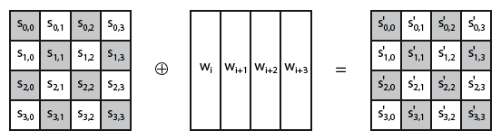
Add Round Key
Notes:
‹#›
Stallings Figure 5.5b illustrates the Add Round Key stage, which like Byte Substitution, operates on each byte of state independently.

Slide 24
AES Key Expansion
takes 128-bit (16-byte) key and expands into array of 44/52/60 32-bit words
start by copying key into first 4 words
then loop creating words that depend on values in previous & 4 places back
in 3 of 4 cases just XOR these together
1st word in 4 has rotate + S-box + XOR round constant on previous, before XOR 4th back
Notes:
‹#›
The AES key expansion algorithm takes as input a 4-word (16-byte) key and produces a linear array of words, providing a 4-word round key for the initial AddRoundKey stage and each of the 10/12/14 rounds of the cipher. It involves copying the key into the first group of 4 words, and then constructing subsequent groups of 4 based on the values of the previous & 4th back words. The first word in each group of 4 gets “special treatment” with rotate + S-box + XOR constant on the previous word before XOR’ing the one from 4 back. In the 256-bit key/14 round version, there’s also an extra step on the middle word. The text includes in section 5.4 pseudocode that describes the key expansion.

Slide 25
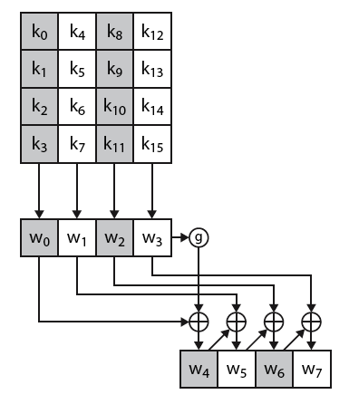
AES Key Expansion
Notes:
‹#›
The first block of the AES Key Expansion is shown here in Stallings Figure 5.9a. It shows each group of 4 bytes in the key being assigned to the first 4 words, then the calculation of the next 4 words based on the values of the previous 4 words, which is repeated enough times to create all the necessary subkey information.

Slide 26
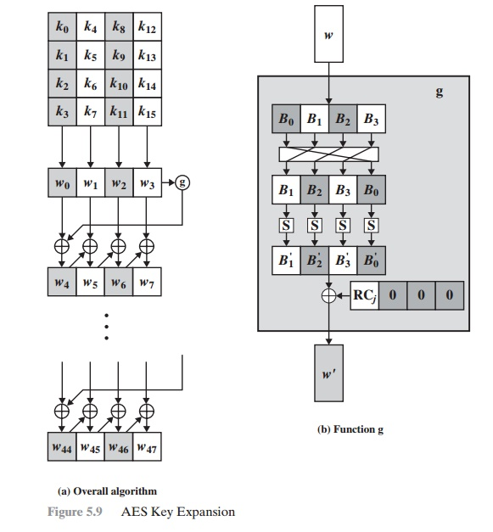

Slide 27
Key Expansion Rationale
designed to resist known attacks
design criteria included
knowing part key insufficient to find many more
invertible transformation
fast on wide range of CPU’s
use round constants to break symmetry
diffuse key bits into round keys
enough non-linearity to hinder analysis
simplicity of description
Notes:
‹#›
The Rijndael developers designed the expansion key algorithm to be resistant to known cryptanalytic attacks. It is designed to be simple to implement, but by using round constants break symmetries, and make it much harder to deduce other key bits if just some are known (but once have as many consecutive bits as are in key, can then easily recreate the full expansion). The design criteria used are listed above.

Slide 28
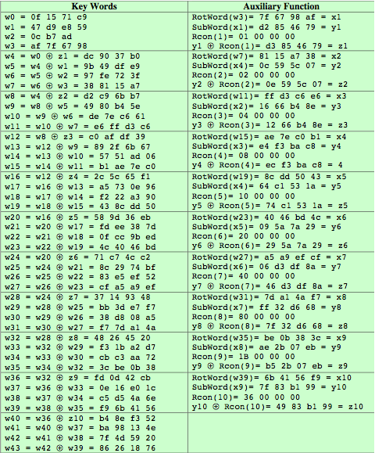
AES Example Key Expansion
Notes:
We now work through an example, and consider some of its implications. The plaintext, key, and resulting ciphertext are as follows:
Plaintext: 0123456789abcdeffedcba9876543210
Key: 0f1571c947d9e8590cb7add6af7f6798
Ciphertext: ff0b844a0853bf7c6934ab4364148fb9
Table 5.3 shows the expansion of the 16-byte key into 10 round keys. As previously explained, this process is performed word by word, with each four-byte word occupying one column of the word round key matrix. The left hand column shows the four round key words generated for each round. The right hand column shows the steps used to generate the auxiliary word used in key expansion. We begin, of course, with the key itself serving as the round key for round 0.
‹#›

Slide 29
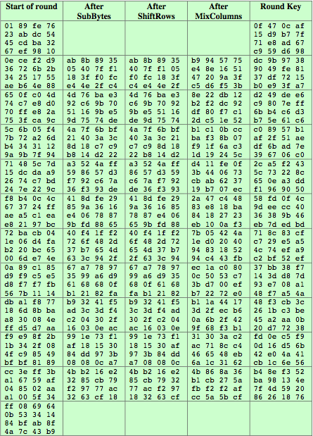
AES Example Encryption
Notes:
Next, Table 5.4 shows the progression of the state matrix through the AES encryption process. The first column shows the value of the state matrix at the start of a round. For the first row, the state matrix is just the matrix arrangement of the plaintext. The second, third, and fourth columns show the value of the state matrix for that round after the SubBytes, ShiftRows, and MixColumns transformations, respectively. The fifth column shows the round key. You can verify that these round keys equate with those shown in Table 5.3. The first column shows the value of the state matrix resulting from the bitwise XOR of the state after the preceding MixColumns with the round key for the preceding round.
‹#›

Slide 30
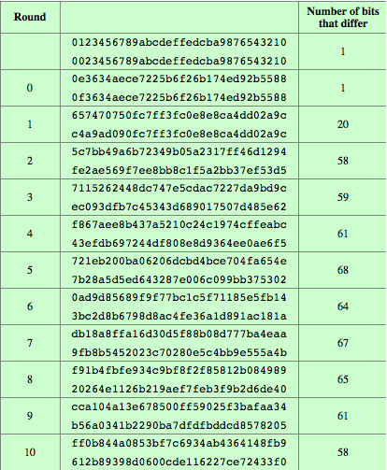
AES Example Avalanche
Notes:
In any good cipher design, want the avalanche effect, in which a small change in plaintext or key produces a large change in the ciphertext. Using the example from Table 5.4, Table 5.5 shows the result when the eighth bit of the plaintext is changed. The second column of the table shows the value of the state matrix at the end of each round for the two plaintexts. Note that after just one round, 20 bits of the state vector differ. And after two rounds, close to half the bits differ. This magnitude of difference propagates through the remaining rounds. A bit difference in approximately half the positions in the most desirable outcome.
‹#›

Slide 31
AES Decryption
AES decryption is not identical to encryption since steps done in reverse
but can define an equivalent inverse cipher with steps as for encryption
but using inverses of each step
with a different key schedule
works since result is unchanged when
swap byte substitution & shift rows
swap mix columns & add (tweaked) round key
Notes:
‹#›
The AES decryption cipher is not identical to the encryption cipher (Stallings Figure 5.3). The sequence of transformations for decryption differs from that for encryption, although the form of the key schedules for encryption and decryption is the same. This has the disadvantage that two separate software or firmware modules are needed for applications that require both encryption and decryption. There is, however, an equivalent version of the decryption algorithm that has the same structure as the encryption algorithm, with the same sequence of transformations as the encryption algorithm (with transformations replaced by their inverses). To achieve this equivalence, a change in key schedule is needed.
By constructing an equivalent inverse cipher with steps in same order as for encryption, we can derive a more efficient implementation. Clearly swapping the byte substitutions and shift rows has no effect, since work just on bytes. Swapping the mix columns and add round key steps requires the inverse mix columns step be applied to the round keys first – this makes the decryption key schedule a little more complex with this construction, but allows the use of same h/w or s/w for the data en/decrypt computation.

Slide 32
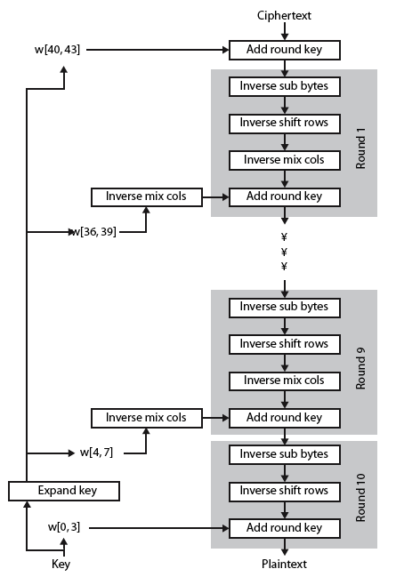
AES Decryption
Notes:
‹#›
Illustrate the equivalent inverse cipher with Stallings Figure 5.10.

Slide 33
Implementation Aspects
can efficiently implement on 8-bit CPU
byte substitution works on bytes using a table of 256 entries
shift rows is simple byte shift
add round key works on byte XOR’s
mix columns requires matrix multiply in GF(2⁸) which works on byte values, can be simplified to use table lookups & byte XOR’s
Notes:
‹#›
The Rijndael proposal [DAEM99] provides some suggestions for efficient implementation on 8- bit processors, typical for current smart cards, and on 32-bit processors, typical for PCs.
AES can be implemented very efficiently on an 8-bit processor.
AddRoundKey is a bytewise XOR operation.
ShiftRows is a simple byte shifting operation.
SubBytes operates at the byte level and only requires a lookup of a 256 byte table S.
MixColumns (matrix multiply) can be implemented as byte XOR’s & table lookups with a 2nd 256 byte table X2, using the formulae shown in Stallings equation 5.9.

Slide 34
Implementation Aspects
can efficiently implement on 32-bit CPU
redefine steps to use 32-bit words
can precompute 4 tables of 256-words
then each column in each round can be computed using 4 table lookups + 4 XORs
at a cost of 4Kb to store tables
designers believe this very efficient implementation was a key factor in its selection as the AES cipher
Notes:
‹#›
AES can also be very efficiently implemented on an 32-bit processor, by rewriting the stage transformation to use 4 table lookups & 4 XOR’s per column of state. These tables can be computed in advance using the formulae shown in the text, and need 4Kb to store.
The developers of Rijndael believe that this compact, efficient implementation was probably one of the most important factors in the selection of Rijndael for AES.

Slide 35
Summary
have considered:
the AES selection process
the details of Rijndael – the AES cipher
looked at the steps in each round
the key expansion
implementation aspects
Notes:
‹#›
Chapter 5 summary.

